Slide 1
Lecture 15: Analytic Provenance
April 10, 2017
SDS235:
Visual Analytics

Slide 2
Announcements
Feedback on FP2 posted
FP3: Initial Prototype live on Moodle (due WEDS by 1pm)

Slide 3
Provenance
Definition:
“origin, source”
“the history of ownership of a valued object or work of art of literature”
Term has been adapted:
Data provenance
Information provenance
Insight provenance
Analytic provenance

Slide 4
Analytic Provenance
Goal:
To understand a user’s analytic reasoning process when using a (visual) analytical system for task-solving.
Benefits:
Training
Validation
Verification
Recall
Repeated procedures
Etc.

Slide 5
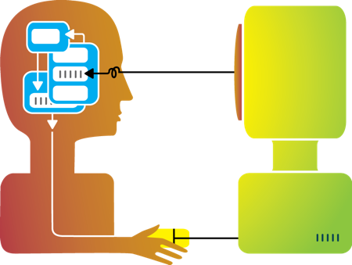

Types of Human-Visualization Interactions
Word editing (input heavy, little output)
Browsing, watching a movie (output heavy, little input)
Visual analysis (closer to 50-50?)

Slide 6
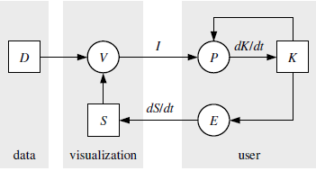
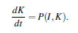
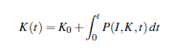
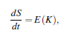
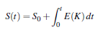
Recap: Van Wijk’s model of visualization
(1)
(2)
(3)
D = Data
V = visualization
S = specification (params)
I = image
P = perception
K = knowledge
E = exploration
(4)
(5)

Slide 7
Discussion: interaction as a data source
What drives user interaction?
What gets encoded during the interaction?
What might it tell us about their reasoning process?

Slide 8

Flashback: Detecting Financial Fraud

Slide 9
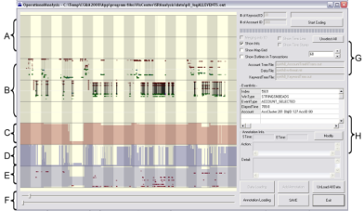
Experiment
Grad
Students
(Coders)
Analysts
Compare!
(manually)
Strategies
Methods
Findings
Guesses of
Analysts’ thinking
Logged
(semantic)
Interactions
WireVis
Interaction-Log Vis

Slide 10
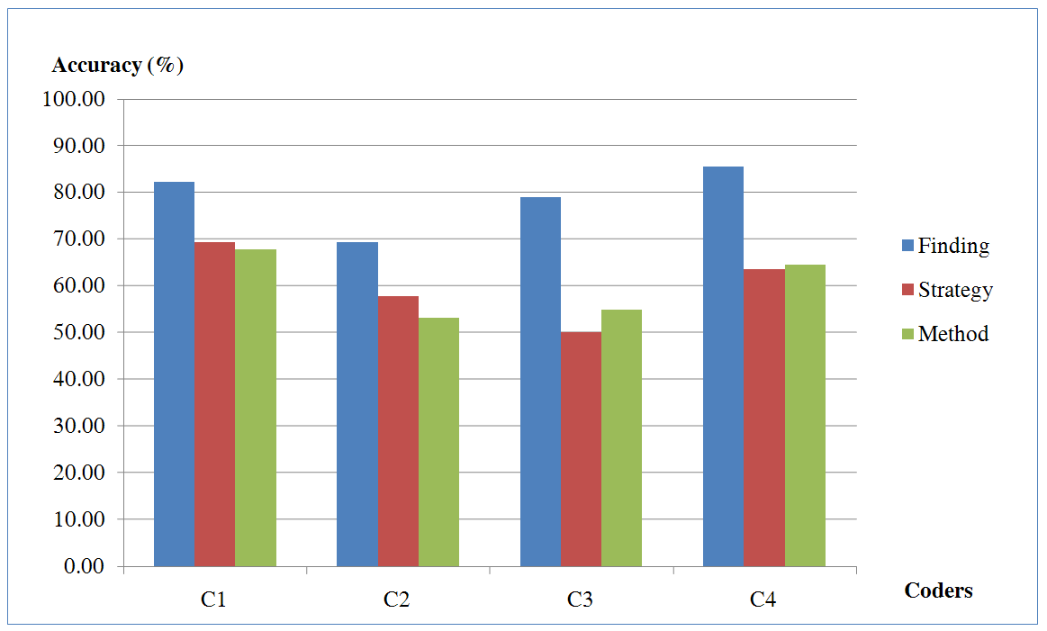
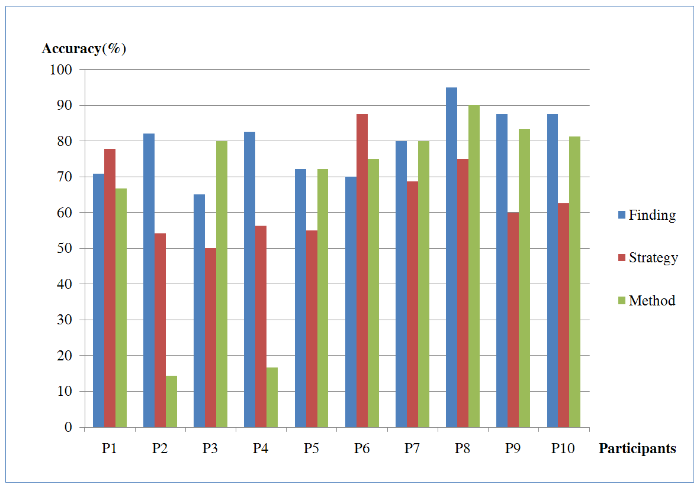
What’s in a user’s interactions?
Why are these two so much lower than others?
(recovering “methods” at about 15%)
R. Chang et al., Recovering Reasoning Process From User Interactions. IEEE Computer Graphics and Applications, 2009.
R. Chang et al., Evaluating the Relationship Between User Interaction and Financial Visual Analysis. IEEE Symposium on VAST, 2009.

Slide 11
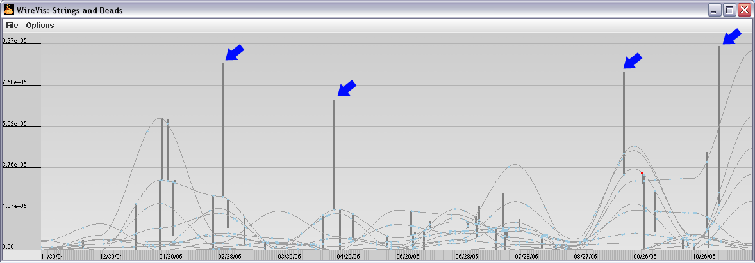
What’s in a user’s interactions?
In this case, only recording a user’s
explicit interaction is insufficient.

Slide 12
Five Stages of Provenance
Perceive: what does the user see?
Capture: which interactions to record, and how?
Encode: how do we want to store the interactions
Recover: how do we translate to something meaningful
Reuse: how can we reapply the interaction to a different problem or dataset?

Slide 13
Five Stages of Provenance
Perceive: what does the user see?
Capture: which interactions to record, and how?
Encode: how do we want to store the interactions
Recover: how do we translate to something meaningful
Reuse: how can we reapply the interaction to a different problem or dataset?

Slide 14
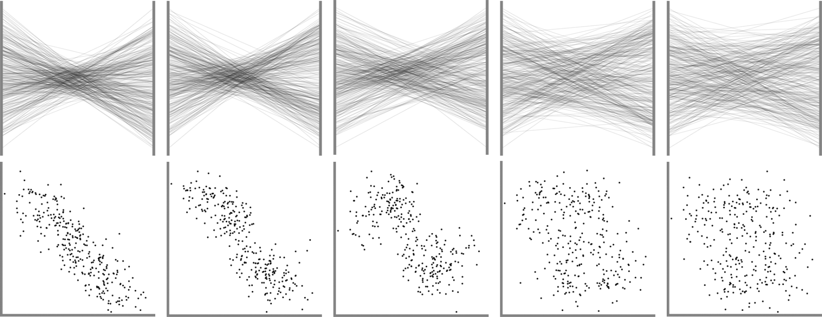
Perceive
What did the user see that prompted the subsequent actions?
Johansson et al. Perceiving patterns in parallel coordinates: determining thresholds for identification of relationships. InfoVis 2008.

Slide 15
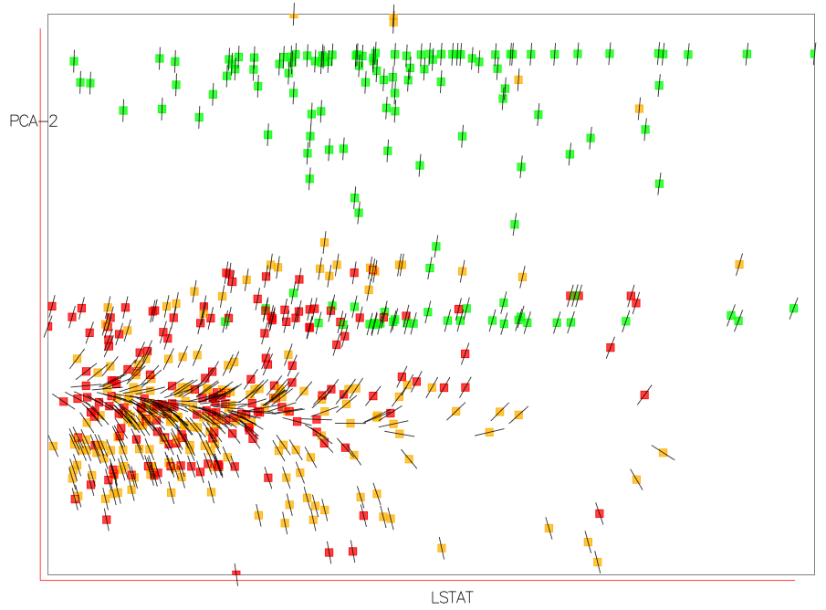
Perceive - Uncertainty
Correa et al. A Framework for Uncertainty-Aware Visual Analytics. VAST 2009.

Slide 16
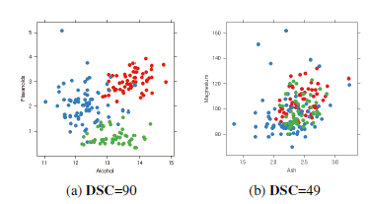
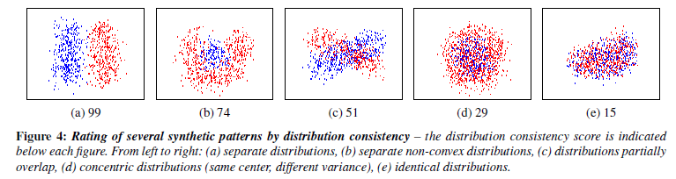
Perceive – Visual Quality
Sipps et al. Selecting good views of high-dimensional data using class consistency. Eurovis 2009.

Slide 17
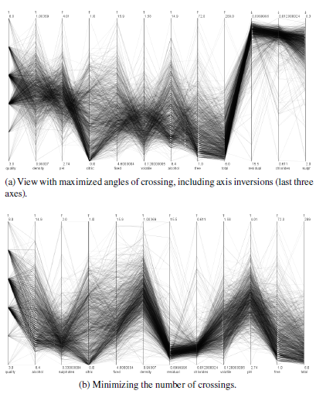
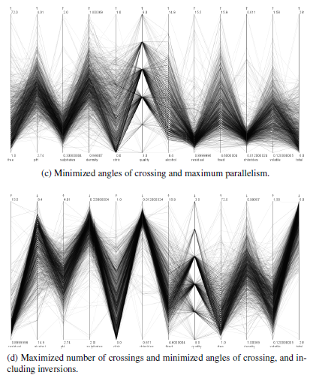
Perceive – Visual Quality
Dasgupta and Kosara. Pargnostics: Screen-Space Metrics for Parallel Coordinates. InfoVis 2010.

Slide 18
Discussion
What other types of visual perceptual characteristics should we (as designers and developers) be aware of?
As a developer, if you know these characteristics, how can you control them in an open exploratory visualization system?

Slide 19
Capture
The “bread and butter” of analytic provenance
Need to choose carefully about “what” to capture
Capturing at too low level → cannot decipher the intent
Capturing at too high level → not usable for other applications

Slide 20
Manual Capturing
When in doubt, ask the user:
Annotations: directly edited text
Structured diagrams: illustrating analytical steps
Reasoning graph: reasoning artifacts and relationships

Slide 21
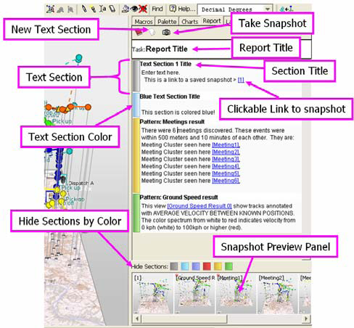
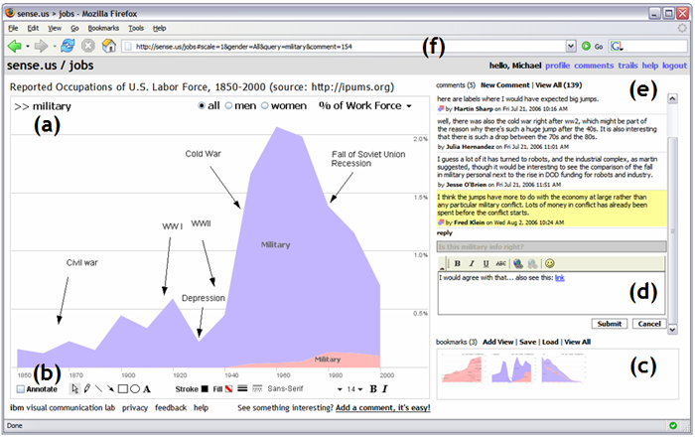
Annotations

Slide 22
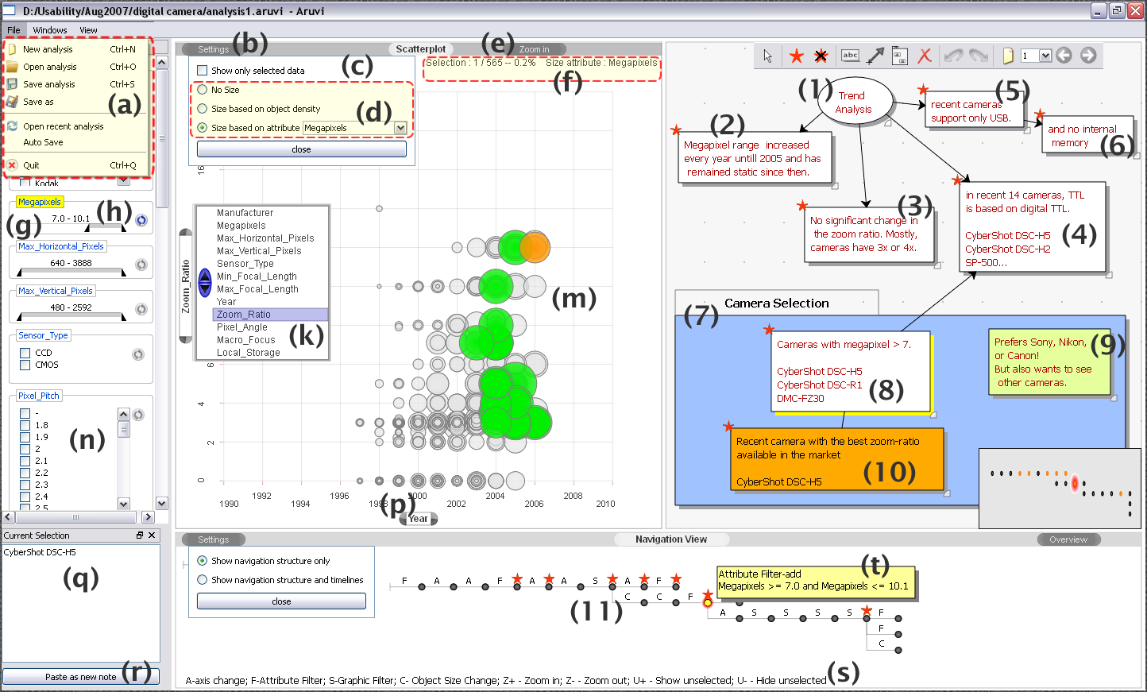
Structured diagrams
Shrinivasan and van Wijk. Supporting the Analytical Reasoning Process in Information Visualization. CHI 2008.

Slide 23
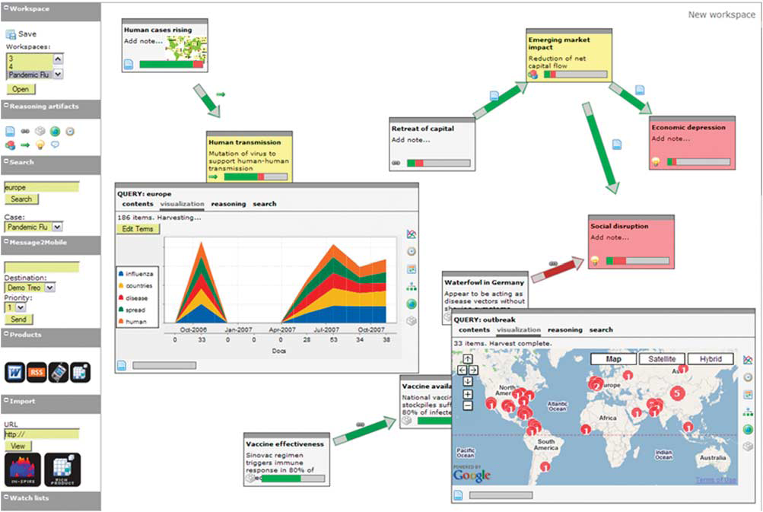
Reasoning graphs

Slide 24
Automatic capturing
Option 1: capture the mouse and key strokes
Option 2: capture the state of the visualization

Slide 25
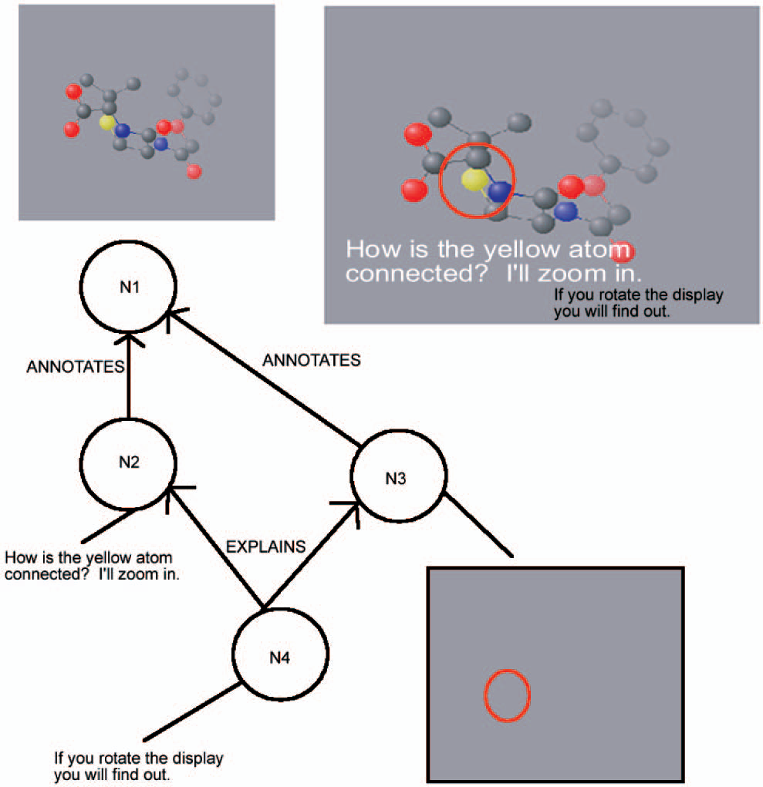
Capturing interaction in a single application
Groth and Streefkerk. Provenance and Annotation for Visual Exploration Systems. TVCG 2006.

Slide 26
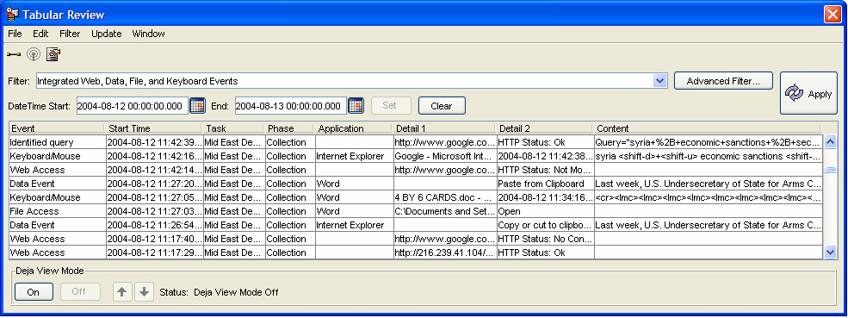
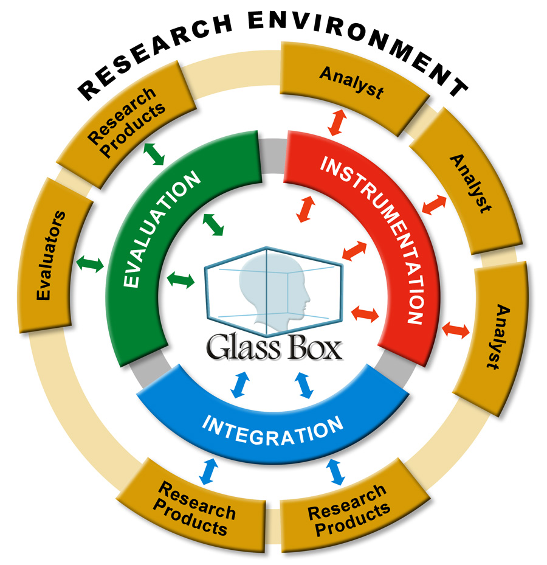
Interaction across multiple platforms
Cowley PJ, JN Haack, RJ Littlefield, and E Hampson. 2006. "Glass Box: Capturing, Archiving, and Retrieving Workstation Activities." In The 3rd ACM Workshop on Capture, Archival and Retrieval of Personal Experiences, CARPE 2006, October 27, 2006, Santa Barbara, California, USA, pp. 13-18 ACM, New York, NY.

Slide 27
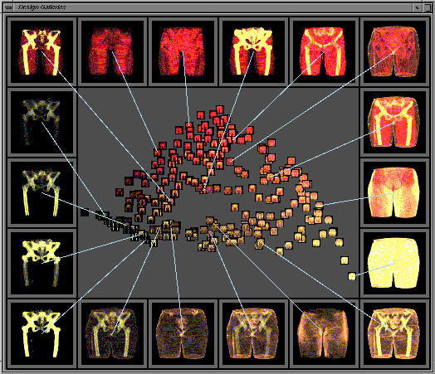
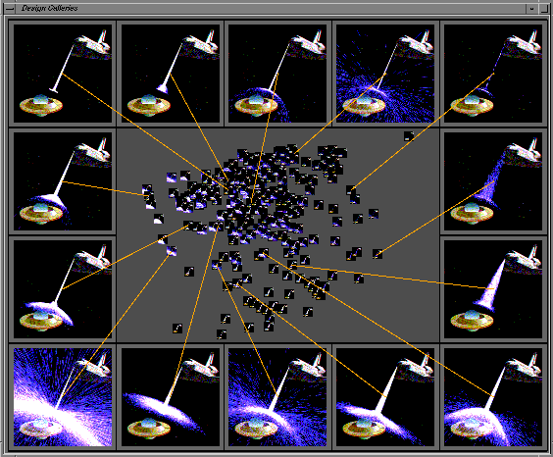
Capturing visualization state (periodic)
Marks et al. Design Gallaries. Siggraph 1997.

Slide 28
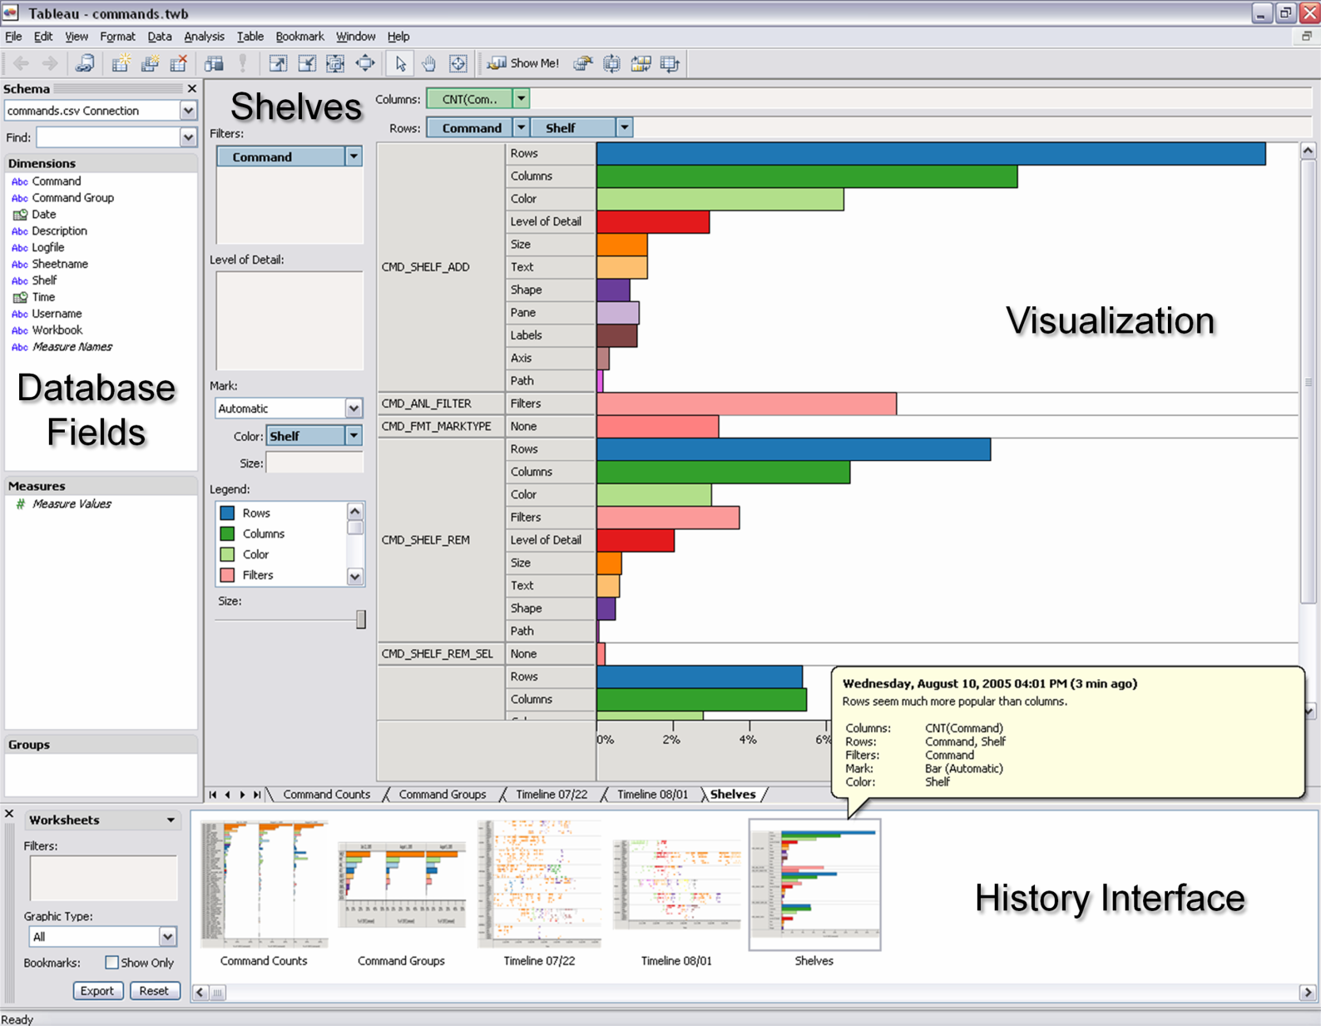
Capturing visualization state (transitions)
Heer et al. Graphical Histories for Visualization: Supporting Analysis, Communication, and Evaluation. InfovVis 2008.

Slide 29
Discussion
How many different levels are there between low level interactions (e.g. mouse x, y) to high level interactions?
What are the pros and cons of manual capturing vs. automatic capturing?
Single application vs. multiple?

Slide 30
Encode
How do we store the captured interactions or visualization states?
Encoding manually captured interactions: could be issues with different “languages”
Encoding automatically captured interactions: more robust description of event sequences and patterns

Slide 31
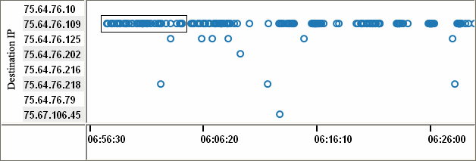
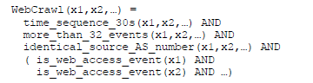
Encoding manual captures
Xiao et al. Enhancing Visual Analysis of Network Traffic Using a Knowledge Representation. VAST 2007.

Slide 32
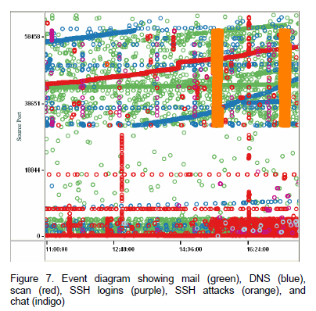
Encoding manual captures

Slide 33
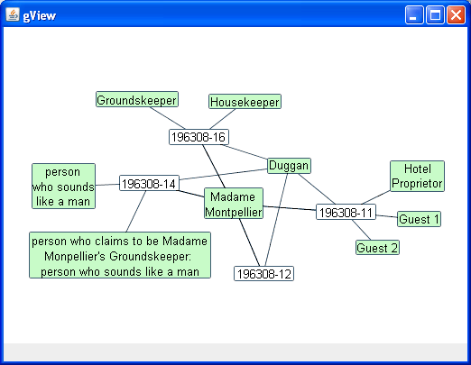
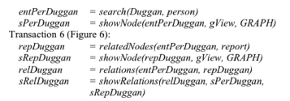
Encoding automatic captures
Kadivar et al. Capturing and Supporting the Analysis Process. VAST 2009.

Slide 34
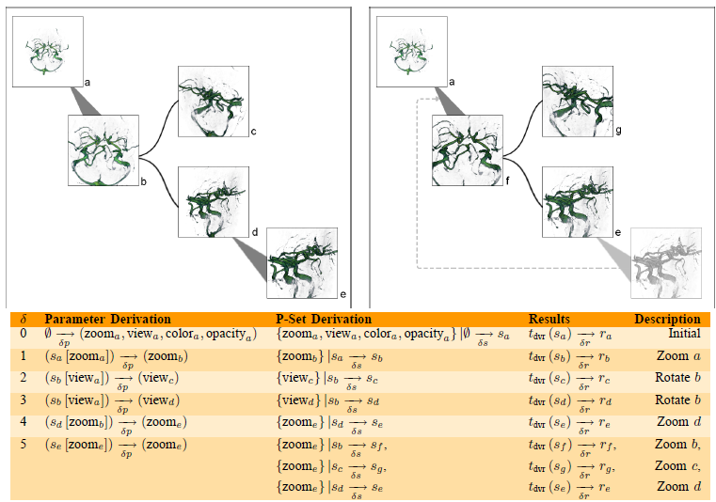
Encoding automatic captures
Jankun-Kelly et al. A Model and Framework for Visualization Exploration. TVCG 2006.

Slide 35
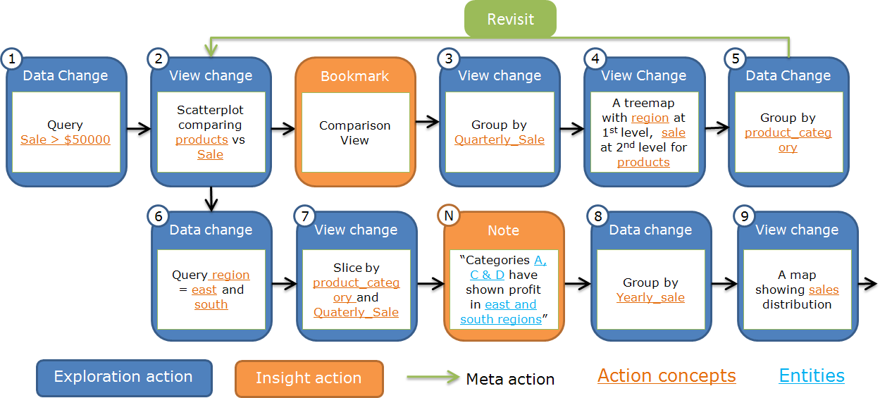
Encoding automatic captures
Shrinivasan et al. Connecting the Dots in Visual Analysis. VAST 2009.

Slide 36
Discussion
Is the use of predicates or inductive logic programming generalizable? Does it scale?
How could we integrate interaction logging and perceptual logging?

Slide 37
Recover
Given all the stored interactions, derive meaning, reasoning processes, and intent
Manually: ask other humans to interpret a user’s interactions
Automatically: ask a computer to interpret a human’s interactions

Slide 38
Manual recovery
From this experiment, we find that interactions contains at least:
60% of the (high level) strategies
60% of the (mid level) methods
79% of the (low level) findings

Slide 39
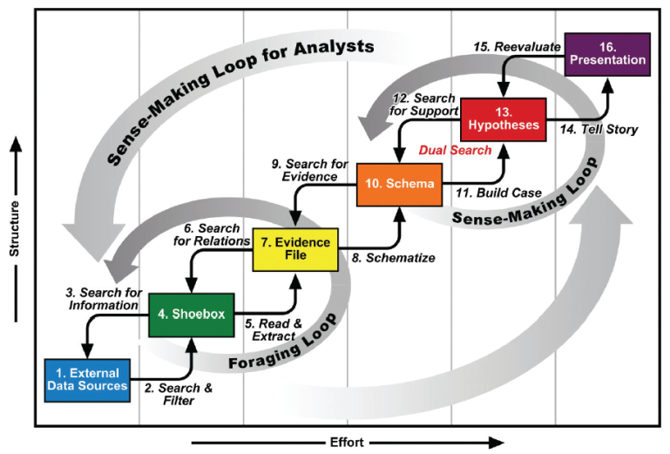
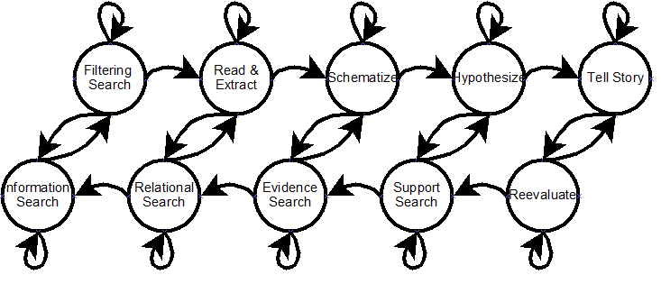
Automatic recovery
Perry et al. Supporting Cognitive Models of Sensemaking in Analytics Systems DIMACS Technical Report 2009.

Slide 40
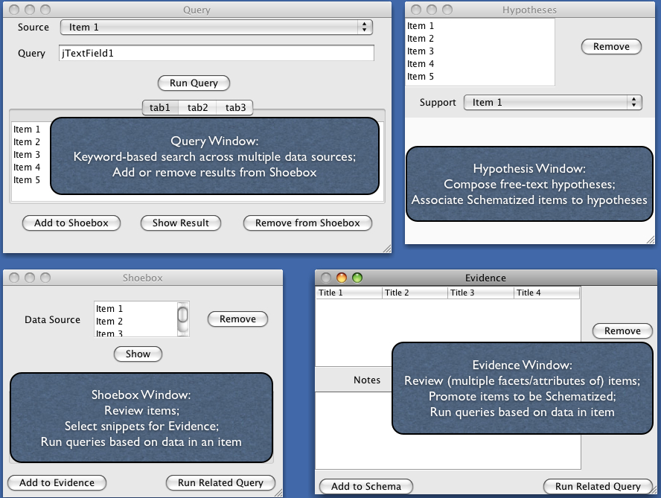
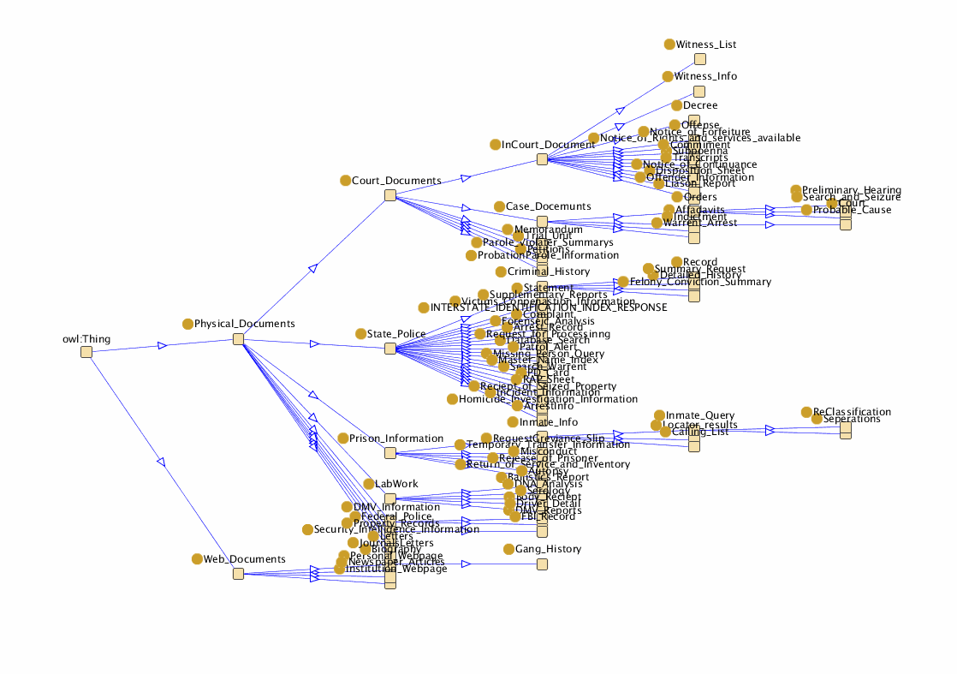
Automatic recovery
Perry et al. Supporting Cognitive Models of Sensemaking in Analytics Systems DIMACS Technical Report 2009.

Slide 41
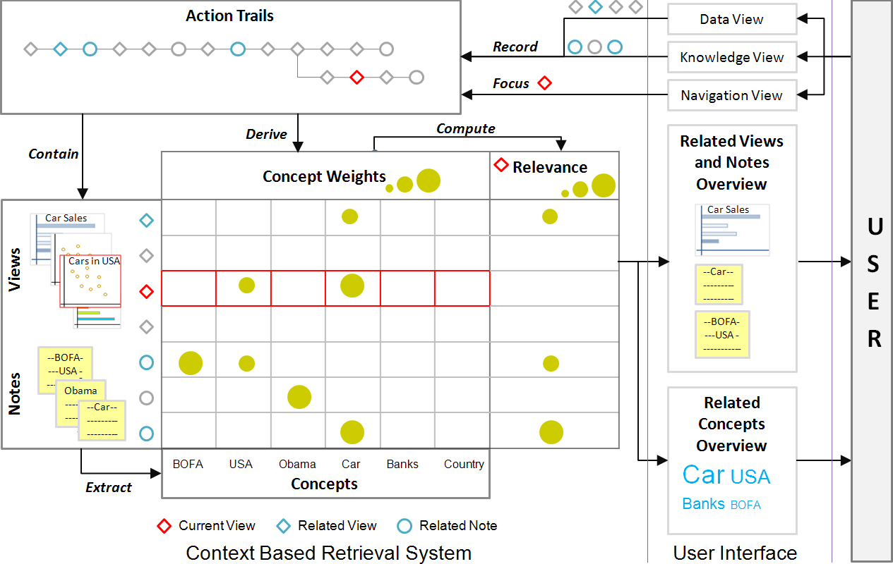
Automatic recovery
Shrinivasan et al. Connecting the Dots in Visual Analysis. VAST 2009.

Slide 42
Discussion
Could we integrate a manually constructed model with automated learning?
What would that entail?

Slide 43
Reuse
Reapply the recovered user interactions, intent, reasoning process, etc. to a different dataset or problem
Reuse user interactions: reapply the recorded interactions with some ability to recover from failures
Reuse analysis patterns: reapply the “rules” learned from previous analysis

Slide 44
Reuse user interactions

Slide 45
Reuse analysis patterns

Slide 46
Discussion
Reuse is only applicable when some combinations of the previous stage(s) are successful
More broadly speaking, does it make sense?
(Familiar) example of reuse

Slide 47
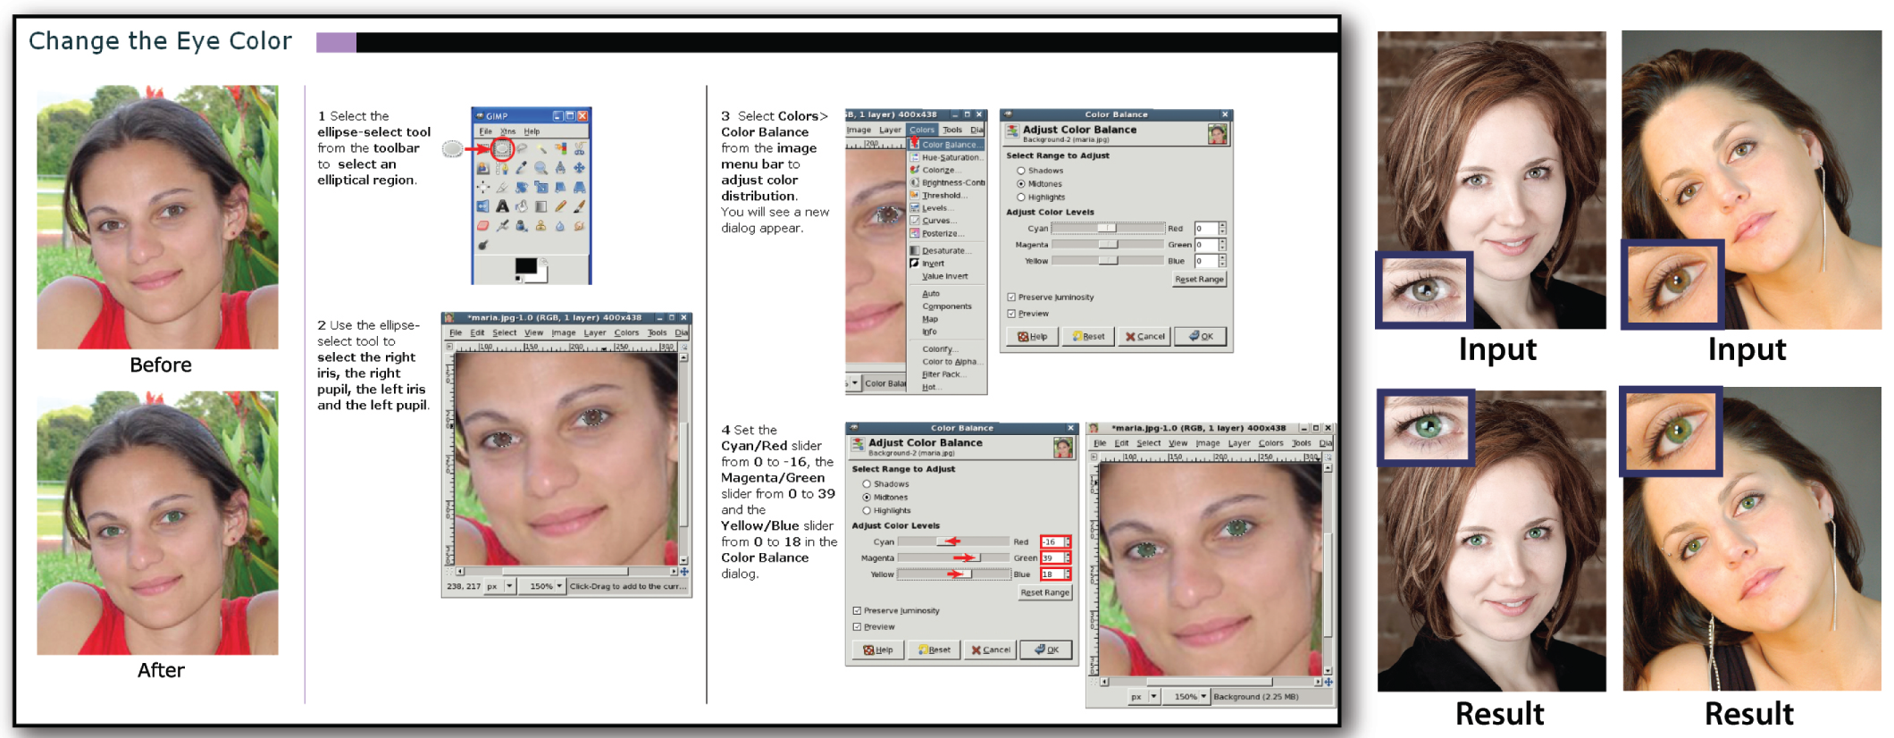
Generating tutorials
Grabler et al. Generating Photo Manipulation Tutorials by Demonstration. SIGGRAPH 2009.

Slide 48
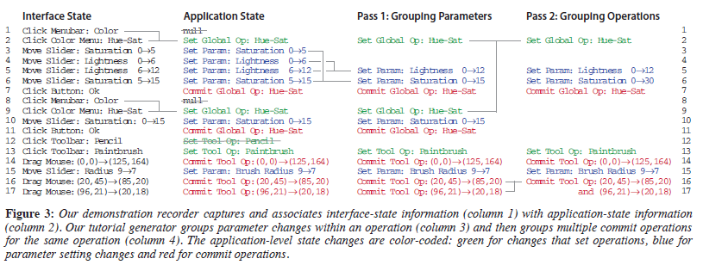
Generating tutorials

Slide 49

Ongoing research
So far: interaction as window into what a user does (when faced with a specific problem)
Recent work: can interaction patterns also be a window into who a user is?

Slide 50
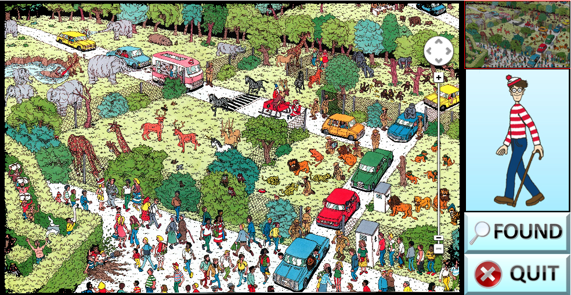
Learning about users from interaction
Brown, Eli T., et al. "Finding Waldo: Learning about Users from their Interactions." (2014).

Slide 51
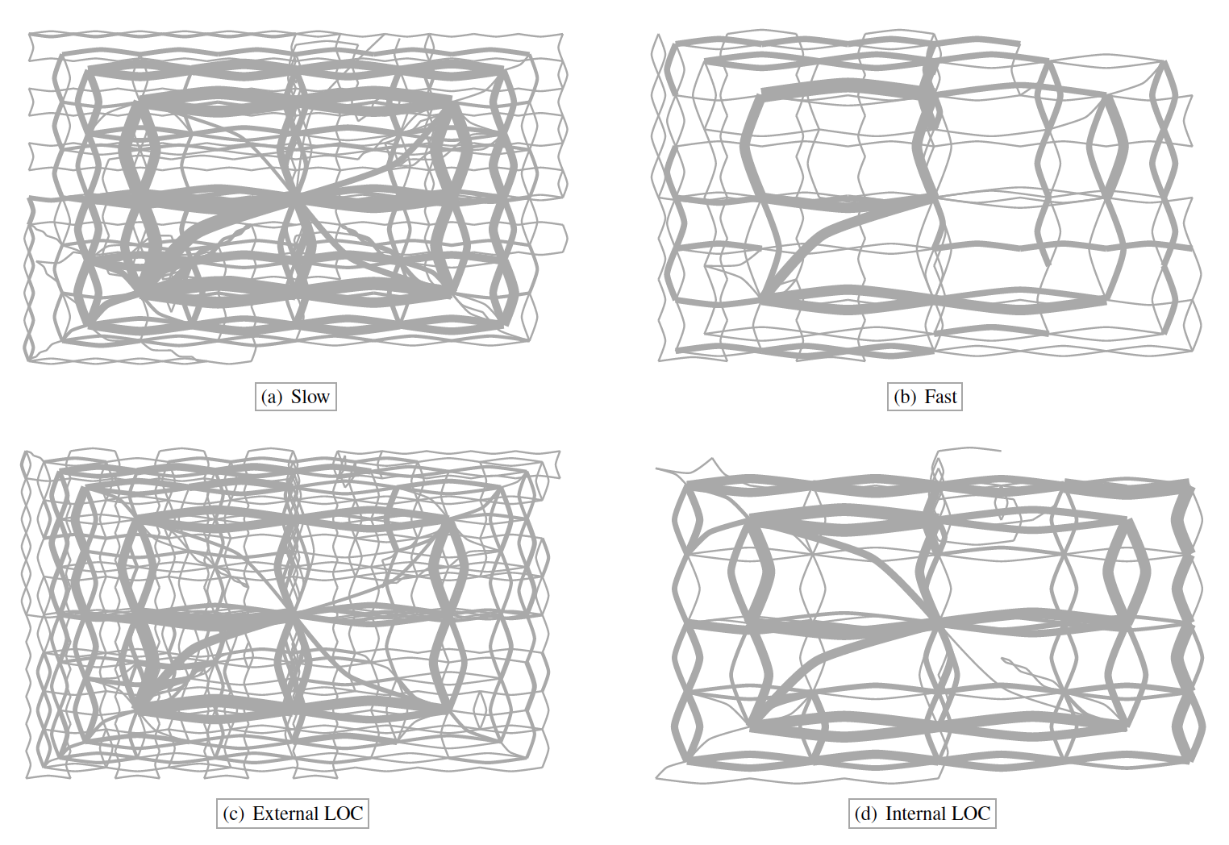
Learning about users from interaction
Brown, Eli T., et al. "Finding Waldo: Learning about Users from their Interactions." (2014).

Slide 52
Coming up
Wednesday: FP workshop pt. 2
FP3: Initial Prototype due BEFORE CLASS

